Slide 1
Project Title Predicting Insurance Premiums
Company: SecureLife Insurance Co.
Name & Role Oluwole Temitope Hannah (Data Scientist )

Slide 2
Project Goal
Build a model to estimate insurance premium
Use data-driven techniques to promotes fairness and profitability
The data set
200,000+ rows, 20 features were used
Mix of numeric, categorical and textual columns
Challenges: Missing data, skewed distributions, formatting issues

Slide 3
Key Techniques Encoding with Scikit-learn Text cleaning with NLTK and TextBlob Feature engineering (e.g., tenure, feedback polarity) Gradient Boosting model + Grid Search Tuning Model Performance
Metric | Score
MAE | ~24.5
MSE | ~1080.3
R-squared | ~0.87

Slide 4
Top Features Visual bar chart of: * Credit Score * Vehicle Age * Health Score * Policy Type * Tenure

Slide 5
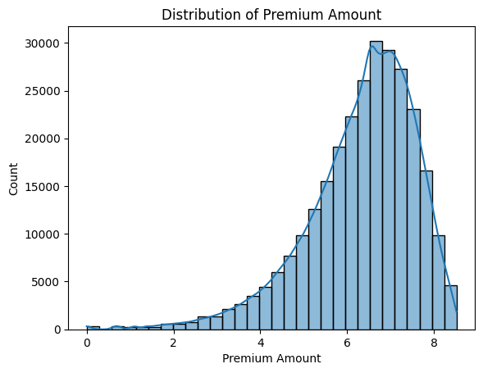
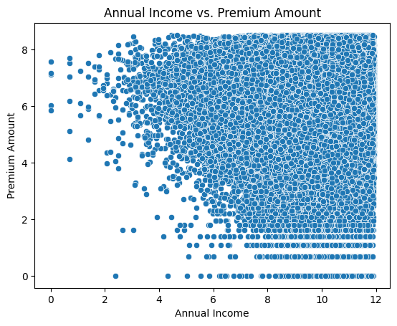
EDA Visuals Slide

Slide 6
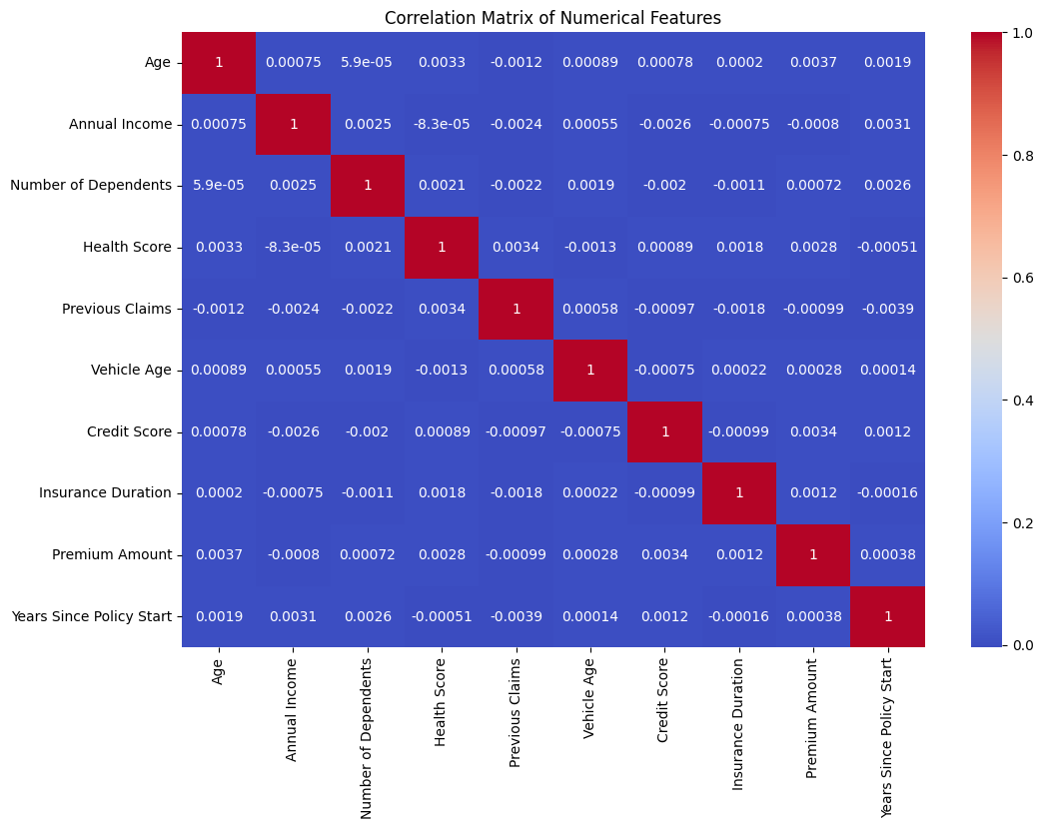
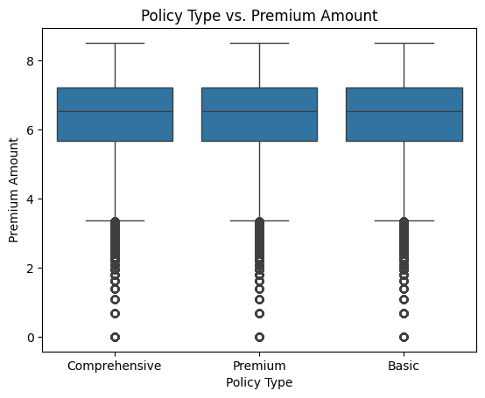

Slide 7
Business Recommendations
Use model for dynamic, personalized pricing
Reward customers with good credit/low-risk profiles
Expand with external data and deeper NLP methods
Deploy estimator via secure web interface
Key Insight - Supports Secure Life’s vision of tech-driven customer care
- Model is scalable, explainable, and impactful
- Ready to deploy and improve insurance outcomes

